Slide 2
SHINE 2023
AGENDA
What is SHINE
Benefits
1-1s and Role Play
Personal Development Conversations and Role Play
Performance Conversations and Role Play

Slide 3
What is it?
A framework to help us understand what we expect of each other and to encourage open performance conversations.
It ensures we know and understand our values, do great work in our teams consistently and ensure we are helping everyone reach their full potential.
Notes:
Ask the group to brainstorm this
Outlines expectations we have for each individual who works here
Linked to our values
Enable consistency and doing great work
Help everyone reach this full potential in their role

Slide 4
‘Hygiene-Motivation’ or ‘Two Factor’ theory
Notes:
Developed by Herzberg
The two-factor theory (motivation-hygiene theory, two/factor dual-factor theory) states that there are certain factors in the workplace that cause job satisfaction while a separate set of factors cause dissatisfaction, all of which act independently of each other.
Hygiene factors (e.g. status, job security, salary, good work conditions, good pay, paid insurance, vacations) that do not give positive satisfaction or lead to higher motivation, though dissatisfaction results from their absence.
Motivators (e.g. challenging work, recognition for one's achievement, responsibility, opportunity to do something meaningful, involvement in decision making, sense of importance to an organization) that give positive satisfaction, arising from intrinsic conditions of the job itself, such as recognition, achievement, or personal growth
The SHINE framework allows us to keep the hygiene factors in check and empower our teams through the motivating factors.

Slide 5
Benefits of SHINE
To you as a People Manager:
Enables you to be consistent in team management
Motivating positive behaviour and action in your team
Create clarity in the team around development and progression
To your team members:
Motivation to perform well
Regular feedback on progress
Guidance on Qs to ask to get the most out of catch ups
Notes:
Creates a framework for providing positive and constructive feedback and creating development plans
For teams members: understand what’s expected of them and creates clarity on roles and responsibilities

Slide 6
Notes:
Serves as a great way to keep people connected while staying true to putting people above process
Think smart act fast
People above process
Exceed expectations
Do the right thing
Clients come first
Respect each other and have fun
Be an entrepenuer

Slide 7
1-1s / Check In’s Weekly Updates / Work related queries Wellbeing check in Feedback
Notes:
General check-in
If managing more senior/experienced people then a bi-weekly check-in might be more suitable
Time to check in on how people are feeling. Any work factors having an impact, i.e. not enough stretch or feeling overwhelmed? Any personal issues impacting them/their work/motivations?
Opportunity to provide positive and constructive feedback (make sure it’s holistic and not always subjective)

Slide 8
ROLE PLAY (1)
A person you manage has come to you and made you aware that they are struggling with their workload. Since you caught up last week they have been feeling overwhelmed by their task list and need some support with prioritising. You feel like their workload is manageable and is comparable to the rest of the team but you want to help them through this difficult period.
Notes:
In Pairs role play this scenario using the SHINE booklet to guide your conversation

Slide 9
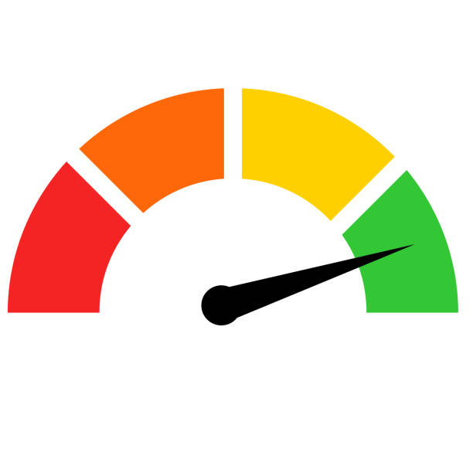
Example Agenda
How are you feeling about each area right now?
Work overall – General feeling about work
Wellbeing – Work-life balance, stress, general wellness
Growth – Learning, Development, Feedback
Work Relationships – People interactions, team dynamics
Impact and Productivity – Progress in tasks, projects, goals
What went well or was a highlight since our last 1-1?
What challenges or roadblocks are you facing right now? How can I help you?
Do you need any more support from me?
Notes:
There is no set process here but we have an example agenda for those team members that might need a little more direction
You could ask your colleague to quantify each area - either with a scale or a number
Go into further detail to understanding these ratings
Any concerns with wellbeing – flag to JHR so we can support
Depending on your ways of working you might need more time and space to run through - Impact and Productivity
Other areas to cover off could include any upcoming holidays – make sure they have time booked in and shared their availability with the team etc.

Slide 10
Personal Development Conversations Monthly Career Path Focus Areas Share Feedback Passions/Motivations
Notes:
Focused check-in to reflect on the success/challenges/achievements over the past month
Opportunity to discuss career development. Any skills gaps that need to be filled in the short term? Any training informal or formal?
Opportunity to provide positive and constructive feedback (make sure it’s holistic and not always subjective)

Slide 11
ROLE PLAY (2)
A person you manage is a consistent high performer and has come on leaps and bounds over the last 6 months and is now looking for some support and guidance on what their areas of focus should be over the next 6 months ahead of their annual catch up
Notes:
In Pairs role play this scenario using the SHINE booklet to guide your conversation

Slide 12
Motivations
Building client relationships
Developing strategy
Creating new ways of working
Making an impact at leadership groups
Leading a team
Developing colleagues
Building specialist expertise
Working creatively
Notes:
Building out motivations from pillars of relationships, growth, achievement and applying these to life and the7stars
What makes up the role -
Consider motivators that matter the most
Those that don’t motivate me

Slide 13
Performance Conversations Review of last 6 – 12 months Annual/Bi-Annual Celebrate your successes Highlight potential development areas
Notes:
Longer term review/reflection of successes/failures over the last 6 months
Forward thinking to the next 6-12 months
Setting clear objectives/KPI’s
Identifying learning needs

Slide 14
ROLE PLAY (3)
A person you manage has told you during their catch up with you that they think they deserve a payrise to reflect the additional work they have been doing. You don’t think they’re ready as their performance hasn’t been consistent over the last year and there are still gaps in their knowledge which they need to focus on before the next step.
Notes:
In Pairs role play this scenario using the SHINE booklet to guide your conversation

Slide 15
Notes:
Share SHINE development summary sheet

